Slide 2
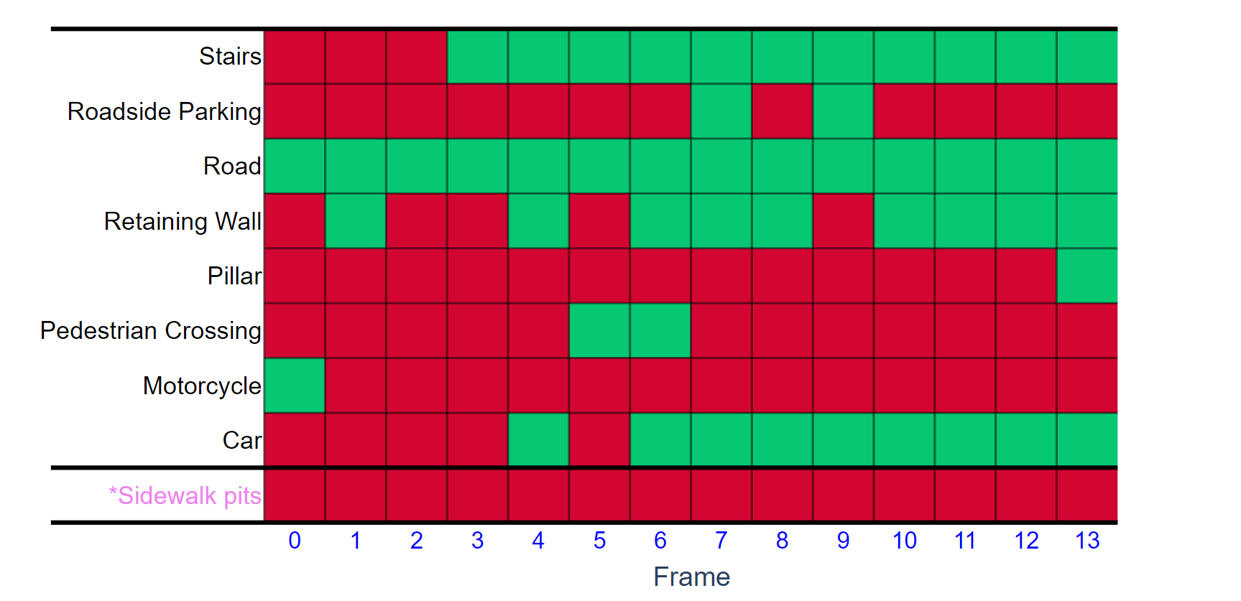
Checker Pattern
Outlier
Outlier Island
Uni-colored Row

